Slide 1

Predicting Population Growth Rate Trends from Human Geography Factors
Rohit Ramarathinam
CS 6375.002

Slide 2

Introduction
Geography has long been an interest of mine. In fact, when I was a kid, I wanted to be a geographer!
Over the last several years, geographers have studied the relationship between human geography factors and the growth of population over time
Human geography is the study of how human activity affects or is affected by the earth and its surface
Thought that combining this with machine learning would be a great way for me to understand how machine learning models work

Slide 3

Goals
The main goal of the project was to predict population growth rate from geographical factors that it has historically been correlated with
Find the best models that do so
Other goals included:
Develop an understanding of how machine learning can be used in the scope of geography
How different machine learning models operate and what do they optimize
The impact and importance of each selected human geographical factor (features) on population growth rate (target)
How tuning the hyperparameters of machine learning models boosts performance and predictions

Slide 4

Method
A simple method was followed and applied to each model implementation:
Shorten dataset
Run model
Feature scaling (if needed)
Feature selection (if needed)
Hyperparameter tuning
Compare evaluation metrics

Slide 5
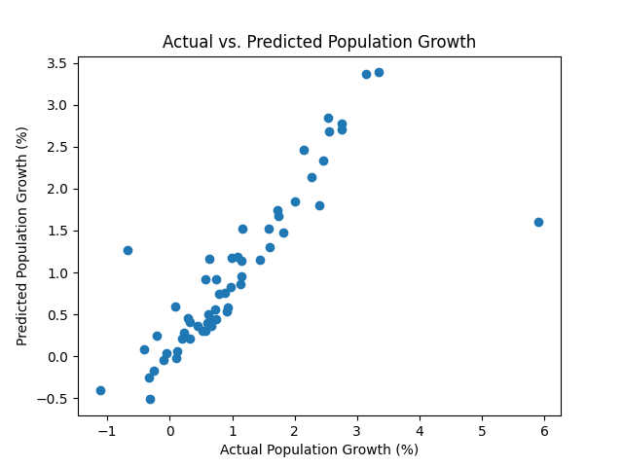
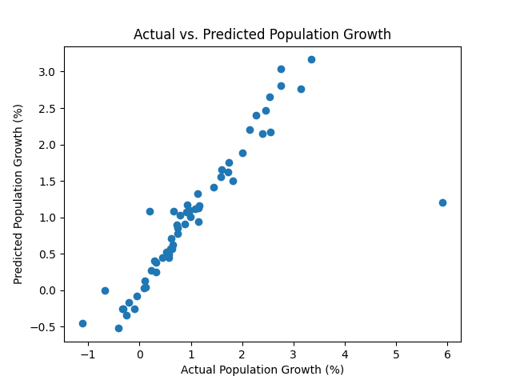

Results
Linear Regression
Support Vector Regression
Ridge Regression

Slide 6
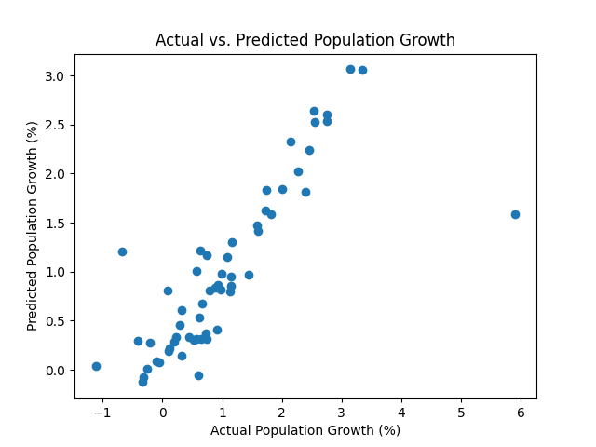
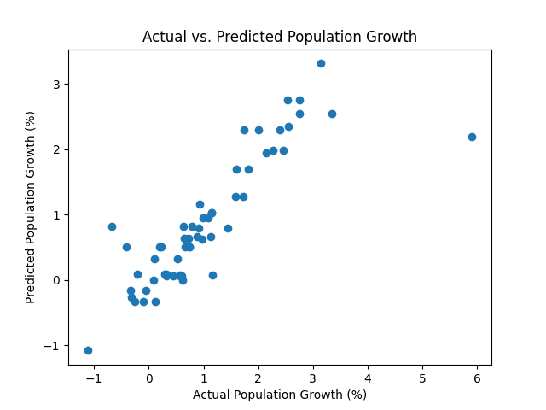
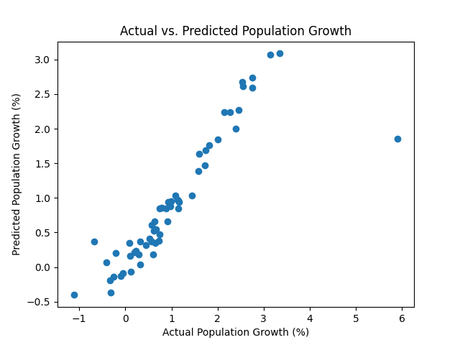
Results (cont.)
Lasso Regression
Decision Tree
Random Forest

Slide 7
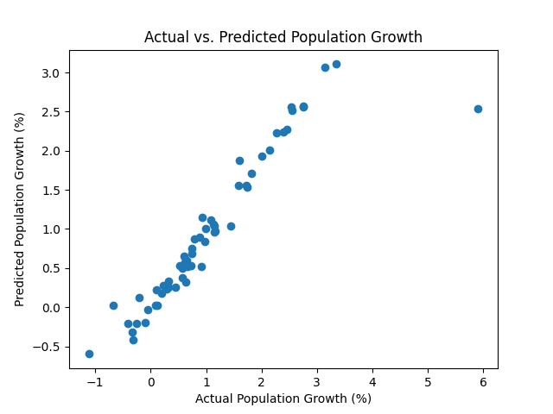
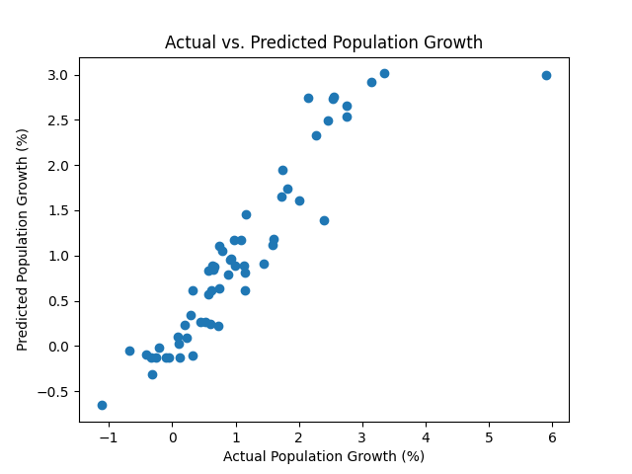
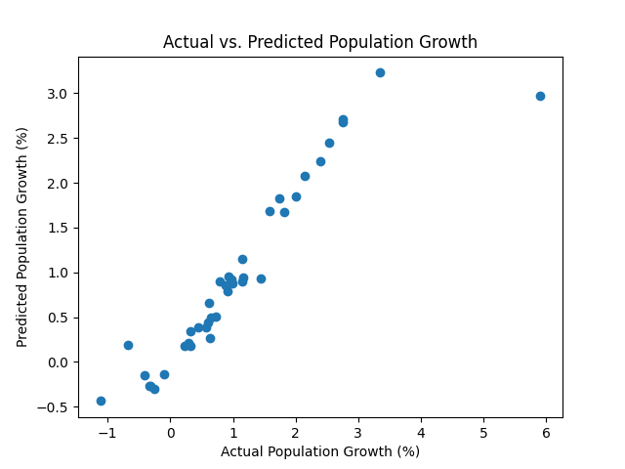
Results (cont.)
Gradient Boosting
KNN
XGBoost

Slide 8

Rankings
Top MSE: 0.229 (Gradient Boosting)
Top R2: 0.836 (Gradient Boosting)
Top models, in order:
Gradient Boosting
KNN
XGBoost
Random Forest
Decision Tree
Support Vector Regression
Linear Regression
Ridge Regression
Lasso Regression

Slide 9

Analysis
All the models, after some tinkering, produced good results
However, in general, the linear models could not achieve the goal of minimizing errors as well as the non-linear models
The dataset was complex enough that linear models required feature scaling or selecting to reduce complexity
The best features included total fertility rate, birth rate, death rate, net migration rate, and median age
Bagging and boosting improved the efficiency of the nonlinear models, feature selection and scaling for the linear models

Slide 10

Conclusion
Non-linear models handle datasets with multicollinearity much better than linear models
Through experimenting and feature engineering, I found that the features were noisy causing simpler models to perform worse without any scaling or feature selection
I was able to get an understanding of the weaknesses of the models as well as their strengths
Overall, this project inspired me to learn more about the wide world of machine learning

Slide 11

Thanks!

